Slide 1
Introduction to Computer Science
Lecture 1
Ust.Hisham Mohammed

Slide 2
OBJECTIVES AND INTENDED OUTCOMES
By the end of this lesson the learner is expected to:
Understand the concept of computer, data, and information.
Learn the characteristics of computers.
Learn the computers classification.
Learn the computer application
Learn the Computer Generations

Slide 3
Computer Definition
A computer is an electronic device through which data can be stored, processed, and then retrieved again when requested as information.
A computer consists of two main components:
Hardware.
Software.

Slide 4
Data, Information, and Knowledge:
Data is the facts fed to the computer in order to process it to benefit from it by the user.
Information is data that has been processed and analyzed to provide knowledge to decision makers and help them achieve certain goals.
Processing is performing some manipulations on the entered data to give the desired results by the program.
storage-arrangement-classification-search-solving mathematical problems-graphics.
Knowledge is Awareness and understanding of a set of information

Slide 5
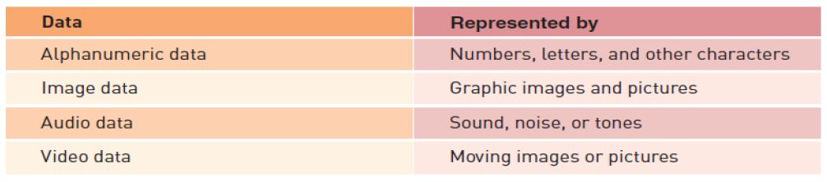
Types of Data

Slide 6
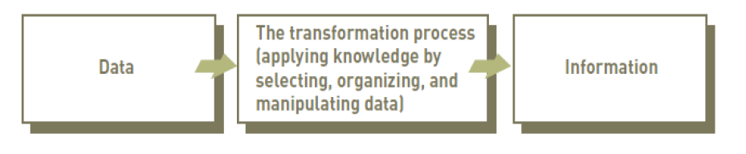
The Process of Transforming data into Information:

Slide 7
Computer Characteristics
Computers differ in size and price and agree on the main characteristics:
Super speed in carrying out operations.
Precision.
Storage possibility.
Multi-used

Slide 8
Classification of Computers
Type of Work
Working Method
Single purpose
Multi-purpose
Analog
Digital
Memory Size
Super Computers Mainframe Computers
Mini Computers Micro Computers

Slide 9
Computer Applications
Computer use has become a measure of progress and development, as it is used in all fields.
official departments and institutions.
Trade and financial affairs
Universities and educational institutions
Airlines Civil
architectural engineering as building design services
The field of health in the management of hospitals

Slide 10
Computer Generations
Lecture1 Part2

Slide 11
Computer Generations
The modern computer took its shape with the arrival of your time. It had been around 16th century when the evolution of the computer started. The initial computer faced many changes, obviously for the betterment. It continuously improved itself in terms of speed, accuracy, size, and price to urge the form of the fashionable day computer. This long period is often conveniently divided into the subsequent phases called computer generations:

Slide 12
Computer Generations
First Generation Computers (1940-1956)
Second Generation Computers (1956-1963)
Third Generation Computers (1964-1971)
Fourth Generation Computers (1971-Present)
Fifth Generation Computers (Present and Beyond)

Slide 13
First Generation Computers: Vacuum Tubes (1940-1956)
The technology behind the primary generation computers was a fragile glass device, which was called vacuum tubes. These computers were very heavy and really large in size. These weren’t very reliable and programming on them was a really tedious task as they used low-level programming language and used no OS. First-generation computers were used for calculation, storage, and control purpose. They were too bulky and large that they needed a full room and consume rot of electricity.

Slide 14
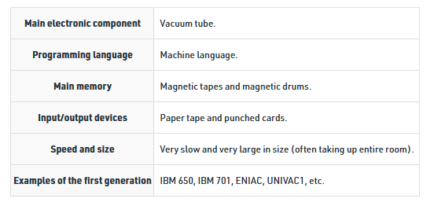
Main characteristics of first generation

Slide 15
Second Generation Computers: Transistors (1956-1963)
Second-generation computers used the technology of transistors rather than bulky vacuum tubes. Another feature was the core storage. A transistor may be a device composed of semiconductor material that amplifies a sign or opens or closes a circuit.
Transistors were invented in Bell Labs. The use of transistors made it possible to perform powerfully and with due speed. It reduced the dimensions and price and thankfully the warmth too, which was generated by vacuum tubes. Central Processing Unit (CPU), memory, programming language and input, and output units also came into the force within the second generation.
Programming language was shifted from high level to programming language and made programming comparatively a simple task for programmers. Languages used for programming during this era were FORTRAN (1956), ALGOL (1958), and COBOL (1959).

Slide 16
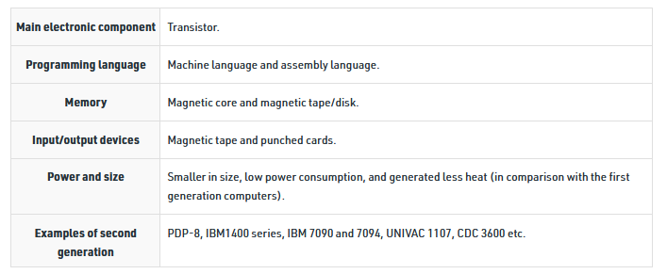
Main characteristics of second generation:

Slide 17
Third Generation Computers: Integrated Circuits. (1964-1971)
During the third generation, technology envisaged a shift from huge transistors to integrated circuits, also referred to as IC. Here a variety of transistors were placed on silicon chips, called semiconductors. The most feature of this era’s computer was the speed and reliability. IC was made from silicon and also called silicon chips.
A single IC, has many transistors, registers, and capacitors built on one thin slice of silicon. The value size was reduced and memory space and dealing efficiency were increased during this generation. Programming was now wiped out Higher level languages like BASIC (Beginners All-purpose Symbolic Instruction Code). Minicomputers find their shape during this era.

Slide 18
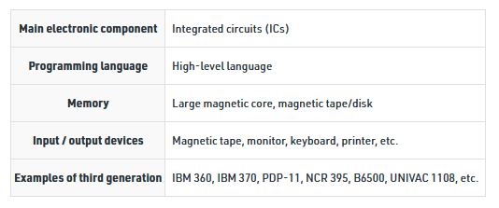
Main characteristics of third generation:

Slide 19
Fourth Generation Computers: Micro-processors (1971-Present)
In 1971 First microprocessors were used, the large scale of integration LSI circuits built on one chip called microprocessors. The most advantage of this technology is that one microprocessor can contain all the circuits required to perform arithmetic, logic, and control functions on one chip.
The computers using microchips were called microcomputers. This generation provided the even smaller size of computers, with larger capacities. That’s not enough, then Very Large Scale Integrated (VLSI) circuits replaced LSI circuits. The Intel 4004chip, developed in 1971, located all the components of the pc from the central processing unit and memory to input/ output controls on one chip and allowed the dimensions to reduce drastically.
Technologies like multiprocessing, multiprogramming, time-sharing, operating speed, and virtual memory made it a more user-friendly and customary device. The concept of private computers and computer networks came into being within the fourth generation.

Slide 20
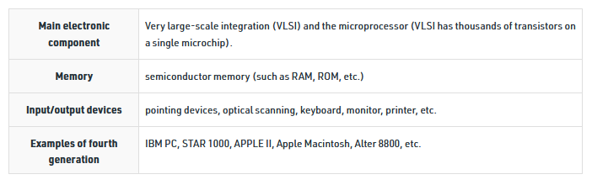
Main characteristics of fourth generation:

Slide 21
Fifth Generation Computers:
The technology behind the fifth generation of computers is AI. It allows computers to behave like humans. It is often seen in programs like voice recognition, area of medicines, and entertainment. Within the field of games playing also it’s shown remarkable performance where computers are capable of beating human competitors.
The speed is highest, size is that the smallest and area of use has remarkably increased within the fifth generation computers. Though not a hundred percent AI has been achieved to date but keeping in sight the present developments, it is often said that this dream also will become a reality very soon.
In order to summarize the features of varied generations of computers, it is often said that a big improvement has been seen as far because the speed and accuracy of functioning care, but if we mention the dimensions, it’s being small over the years. The value is additionally diminishing and reliability is in fact increasing.

Slide 22
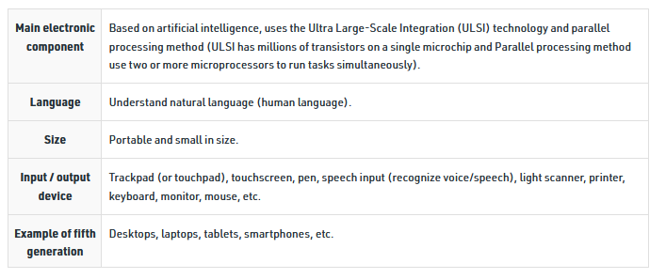
Main characteristics of fifth generation

Slide 23
Any Question???

